Slide 1
PIPE JACKING
An introduction to pipe jacking prepared by the Pipe Jacking Association
Notes:
This introduction to pipe jacking has been prepared by the Pipe Jacking Association as an aid to engineers and others seeking an introduction to the science and art of pipejacking.

Slide 2
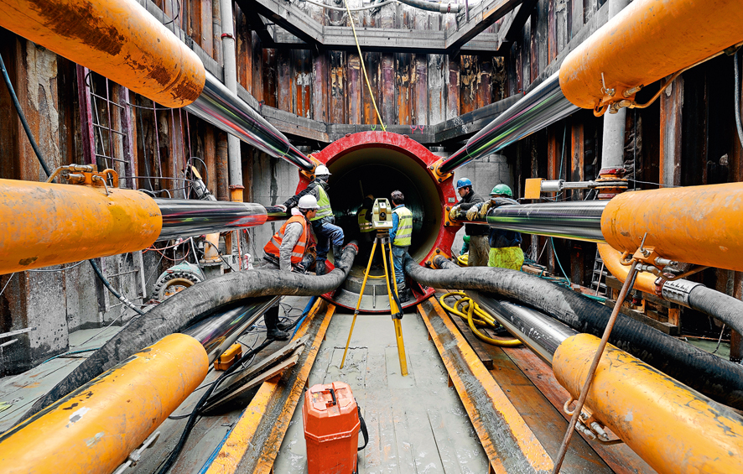
Pipe Jacking
Notes:
Pipe jacking is a tunnelling technique for the installation of pipes using powerful hydraulic jacks to drive purpose designed pipes through the ground at the same time as excavation is taking place at the face.

Slide 3
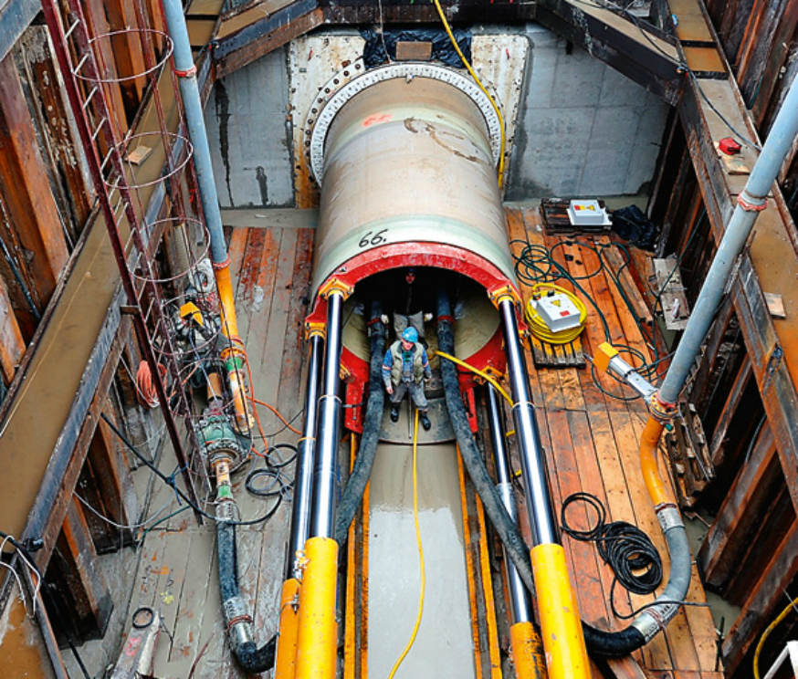
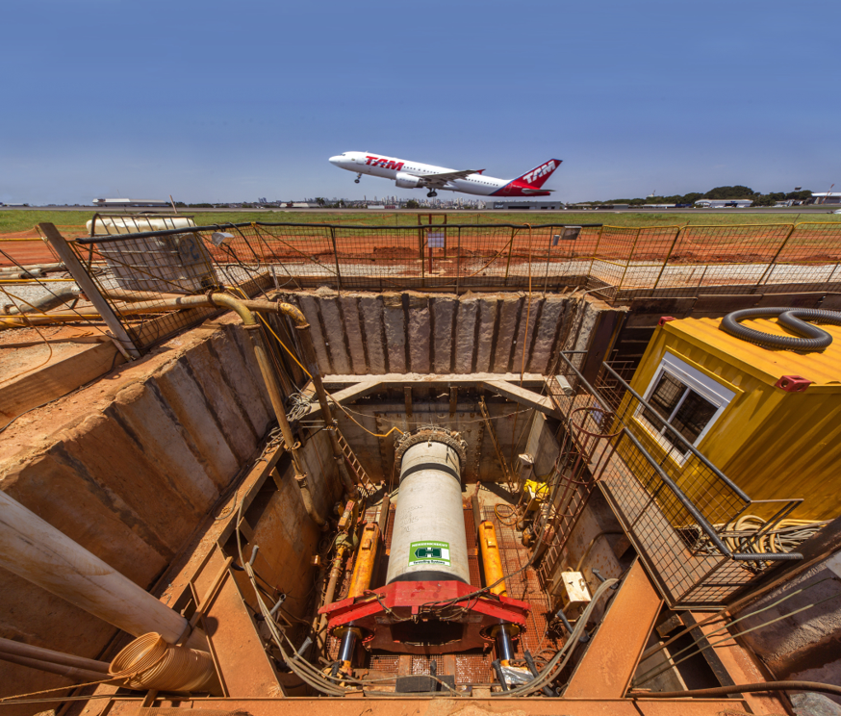
Pipe Jacking
Notes:
A range of machines are available, to suit varying ground conditions, to install pipes typically in the range 150 to 2,400 mm or greater if required. Lengths of up to a kilometre or more can be jacked depending on ground conditions and pipe diameter. Drives can be either in a straight line, to a radius or a series of radii. Concrete, Grp, clay and steel pipes can be jacked.

Slide 4
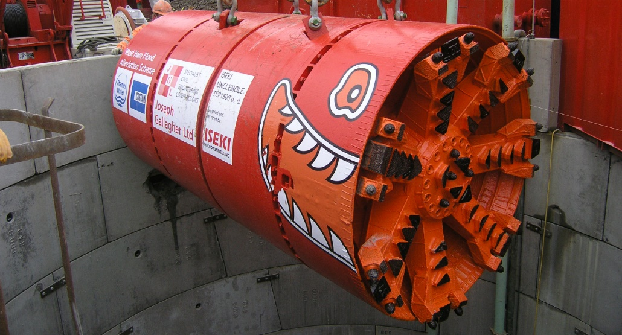
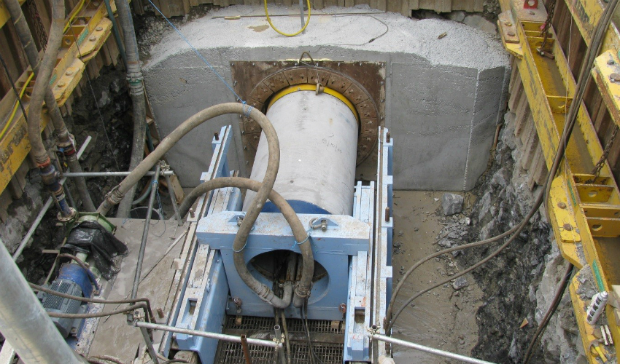
Microtunnelling
Notes:
In smaller non-man entry diameters, generally one metre and below, the system is often referred to as microtunnelling although this term is also used to describe automated tunnelling operations in larger diameters.

Slide 5
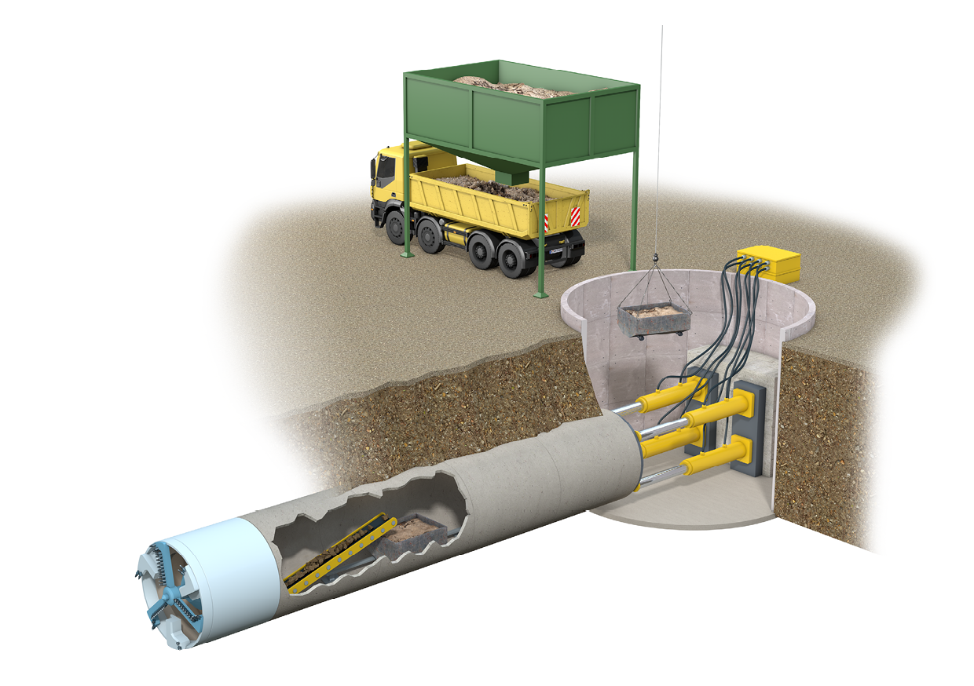
Pipe Jacking - General Arrangement
Pipe Jacking is an integrated system linking:
soils
jacking shafts
pipes
shields
jacking loads
engineering
Notes:
The integrity of a pipe jacking operation is dependent upon the inter-relationship of a number of factors: soil investigation and interpretation; jacking shaft design; pipe design; pipejack shield selection; hydraulic considerations; and laser engineering and control.

Slide 6
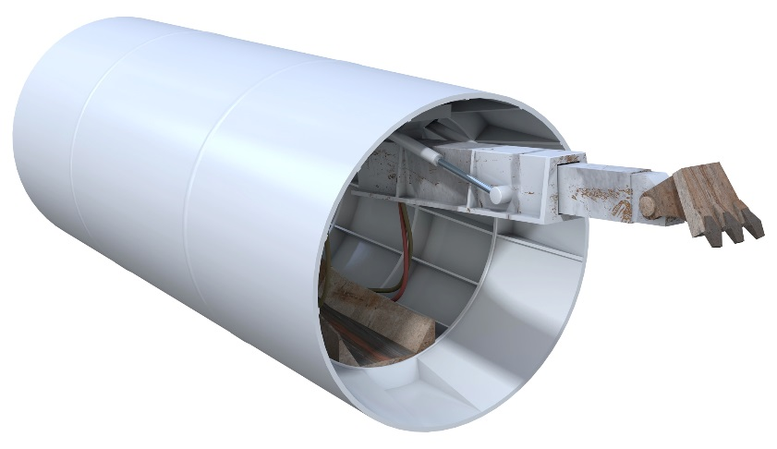
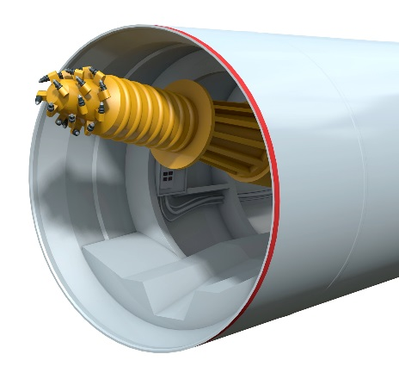
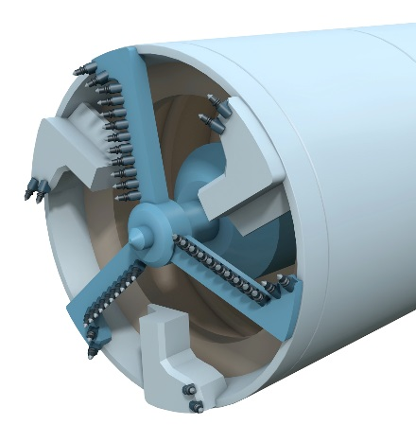
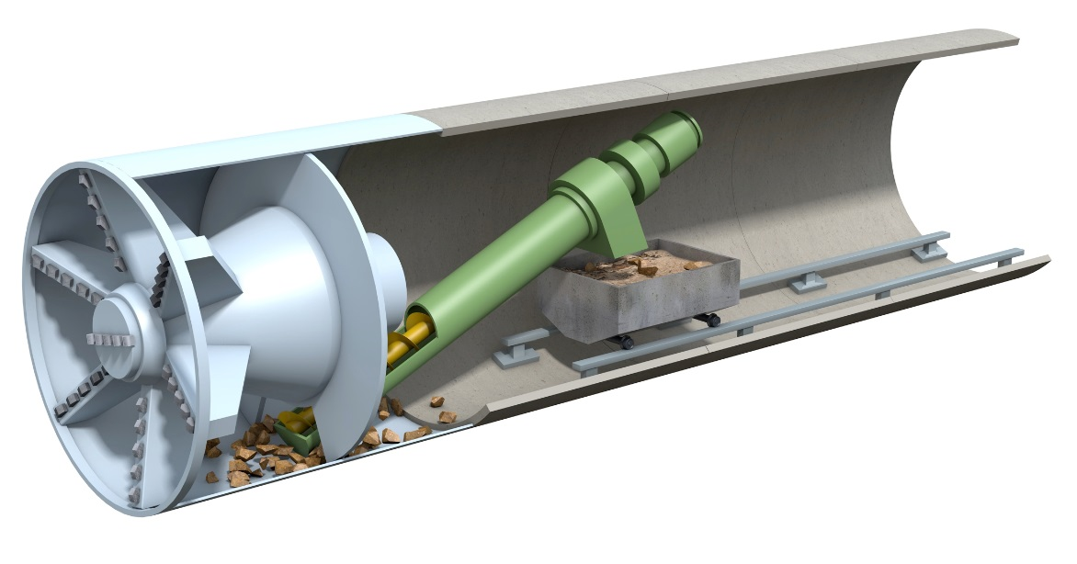
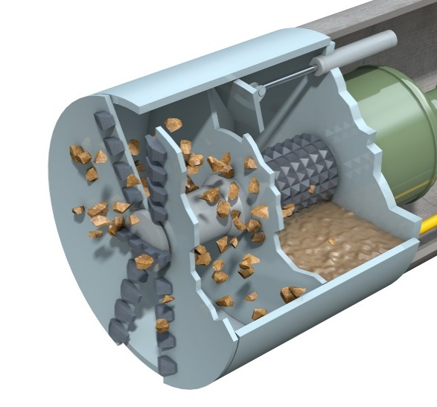
Machine Technology
Machines are available for pipe jacking in most ground conditions
Notes:
The latest tunnelling technology has been incorporated into pipe jacking excavation systems and a range of machines are available for pipejacking in most ground conditions from soft water bearing strata to hard rock.

Slide 7
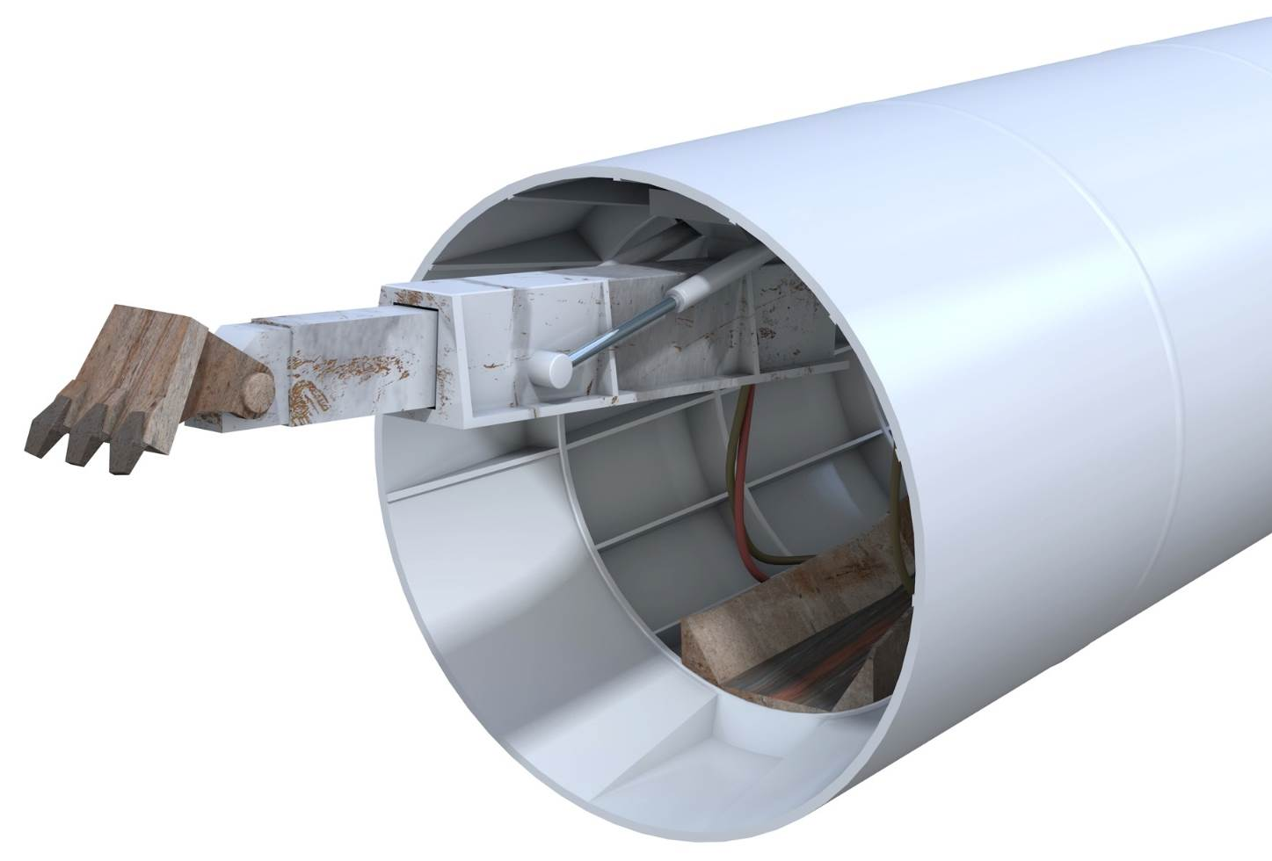
Machine Technology
Machines are available for pipe jacking in most ground conditions
  Backacters
Notes:
A backacter – an open face shield in which a mechanical backacter is mounted for excavation purposes.

Slide 8

Machine Technology
Machines are available for pipe jacking in most ground conditions
  Backacters
  Open face cutter booms
Notes:
An open face cutter boom – an open face shield in which a cutter boom is mounted for excavation purposes.

Slide 9

Machine Technology
Machines are available for pipe jacking in most ground conditions
  Backacters
  Open face cutter booms
  Tunnel boring machine
Notes:
A tunnel boring machine – a shield having a rotating head. Various cutting heads are available to suit a broad range of ground conditions.

Slide 10

Machine Technology
Machines are available for pipe jacking in most ground conditions
  Backacters
  Open face cutter booms
  Tunnel boring machine
  Earth pressure balance
Notes:
An earth pressure balance machine or EPBM – a full-face tunnel boring machine in which the excavated material is transported from the face by a balanced screw auger or screw conveyor. The face is supported by excavated material held under pressure behind the cutter head in front of the forward bulkhead. Pressure is controlled by the rate of passage of excavated material through the balanced screw auger or valves on the screw conveyor.

Slide 11

Machine Technology
Machines are available for pipe jacking in most ground conditions
Backacters
Open face cutter booms
Tunnel boring machine
Earth pressure balance
Pressurised slurry
Notes:
A slurry machine - another full-face tunnel boring machine in which the excavated material is transported from the face suspended in a slurry. Various cutting heads are available to suit a broad range of ground conditions and may incorporate internal crushers to deal with cobbles and small boulders. The pressure of the slurry is used to balance the groundwater and face pressure.

Slide 12
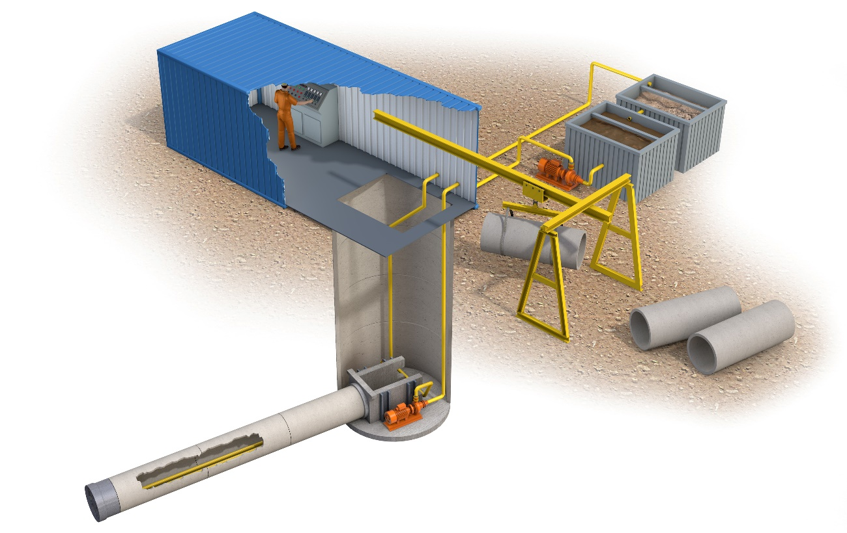
Microtunnelling
Fully guided machines
Controlled from surface
Non man entry
Two options:
  Pressurised slurry
  Screw auger
Notes:
These fully guided machines are remotely controlled from the surface. There are generally two types, both having face support capability, pressurised slurry and auger machines.

Slide 13
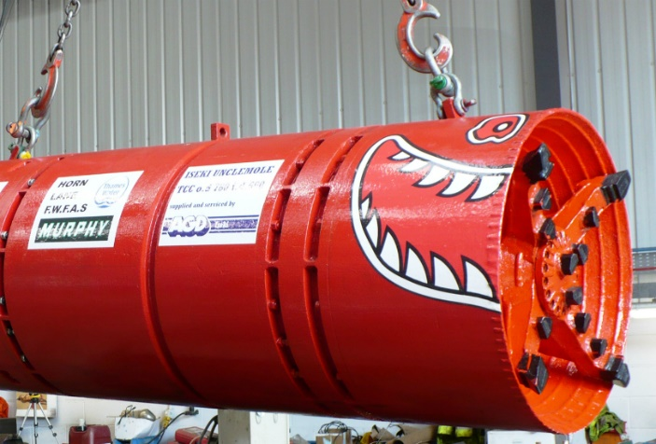
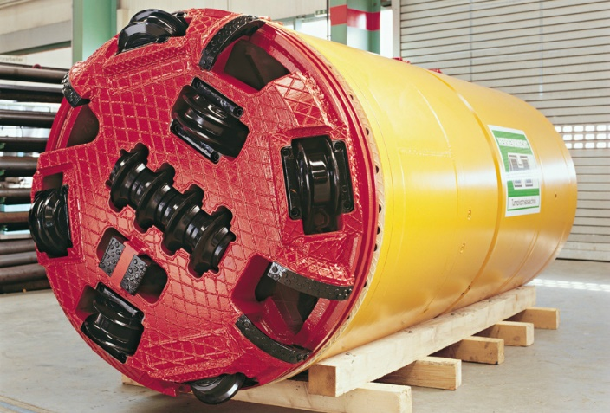
Benefits of Mechanisation
Significantly safer working
Efficient
Hand arm vibration eliminated
Quicker installation
Ground support
Remote control
Risks mitigated
Notes:
To summarise, the range of mechanised excavation systems available offer a combination of rapid excavation and safety mechanisms to control potentially unstable ground conditions. In addition remote controlled pipe jacking in contaminated ground avoids risks to operatives.

Slide 14
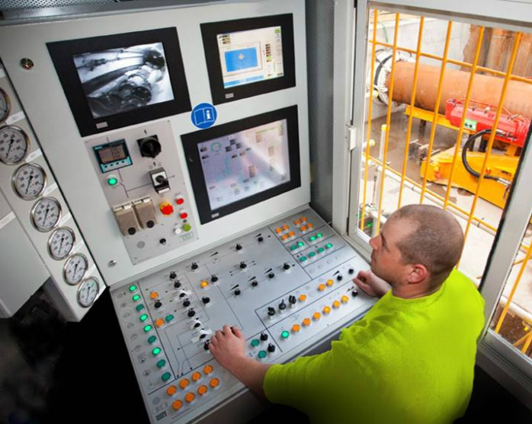
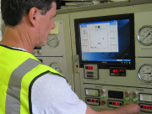
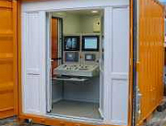
Computer Guidance
Real-time line and level checks
Maintains accuracy in difficult
ground
Allows remote operations
Notes:
Guidance systems linked to an operator console enable continual line and level checks. Far greater control of accuracy and tolerance compliance is ensured even in the most difficult ground. The requirement for man-entry into the pipejack is minimised with surveying operations managed from the surface.

Slide 15
Drive Lengths, Diameter and Accuracy
Indicative jacking lengths achievable between shafts for mechanised drives, based on PJA members’ experience and lengths being achieved internationally for both straight and curved drives appear below:
Diameter (m) <0.9 0.9 1.0 1.2 1.35 1.5 1.8 1.9 2.1 2.4
Lengths (m) 150 200 250 450 550 700 900 1000 1000 2000
Accuracy:
In stable self-supporting homogenous ground typical tolerances for pipe installation are ±50mm for line and level at any point in the drive.
A risk analysis should be undertaken on all drives to ensure all foreseeable hazards to include access and egress of operatives and any other risks are adequately considered.
Notes:
Tunnelling technology enables mechanised drives up to a kilometre or greater to be undertaken depending on pipe diameters. When operatives are working within the tunnel a risk analysis must be undertaken to ensure all hazards are assessed to include access and egress. In stable, self-supporting homogenous ground, typical tolerances for pipe installation are ±50 mm of line and level.

Slide 16
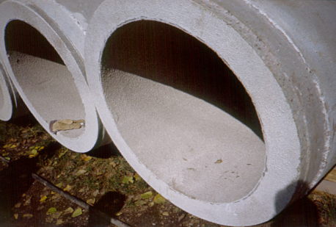
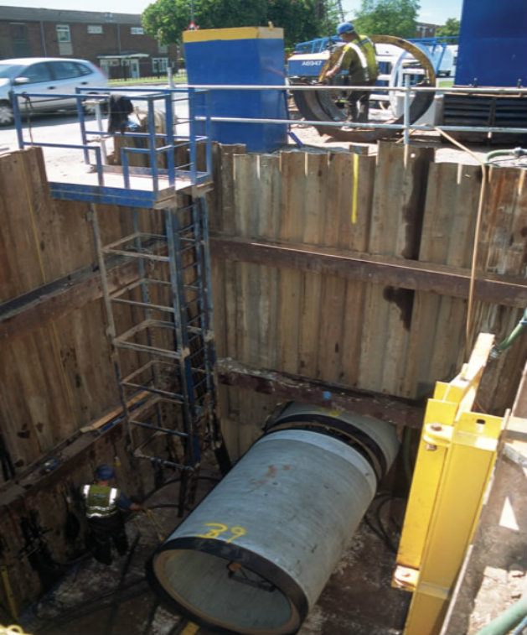
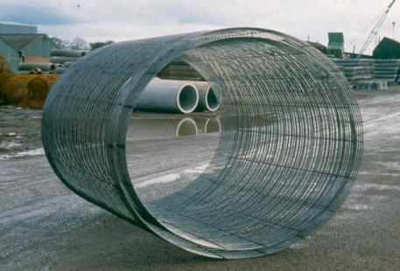
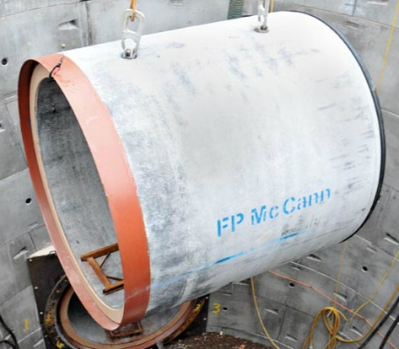
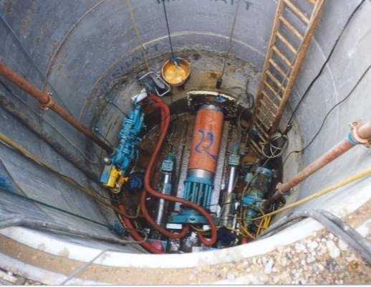
Pipe Jacking Pipes
Concrete jacking pipes:
BS EN 1916
Clay pipes: BS EN 296-7
and BS EN 12899: 2000
Installation forces are key
Follow manufacturers
recommendations
Steel pipes: sleeves for
pressure mains
Notes:
A range of materials are used as pipe jacking linings to include concrete, grp, clay and steel. Concrete jacking pipes which usually incorporate reinforcement, and have flexible joints, and clay pipes, should be manufactured in accordance with relevant standards.

Slide 17
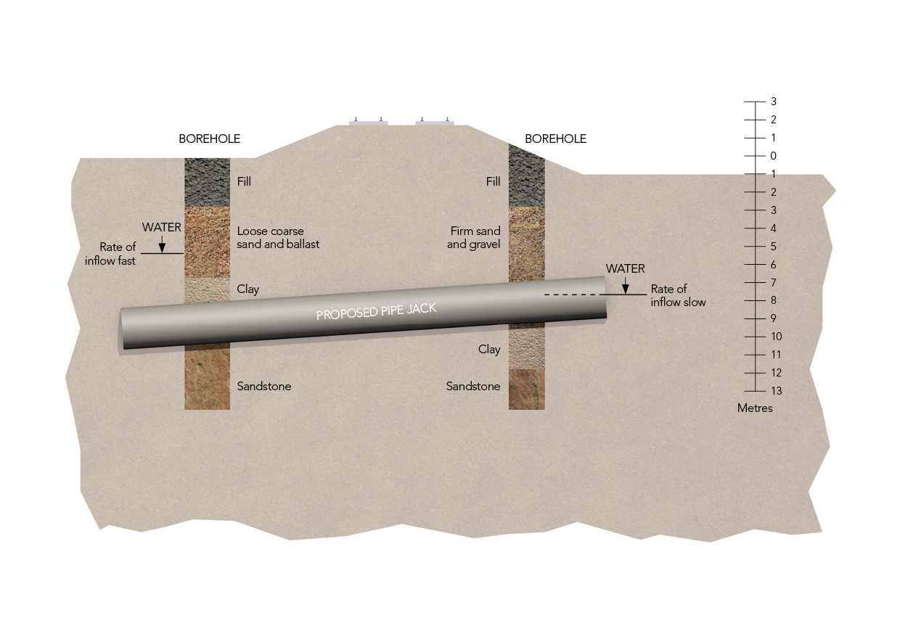
Site Investigation
Notes:
Site investigation is the most important pre-requisite for any tunnelling project. This should be carried out by a suitably qualified geotechnical specialist or geotechnical adviser with considerable experience of tunnelling schemes, under the general direction of the tunnel designer.

Slide 18
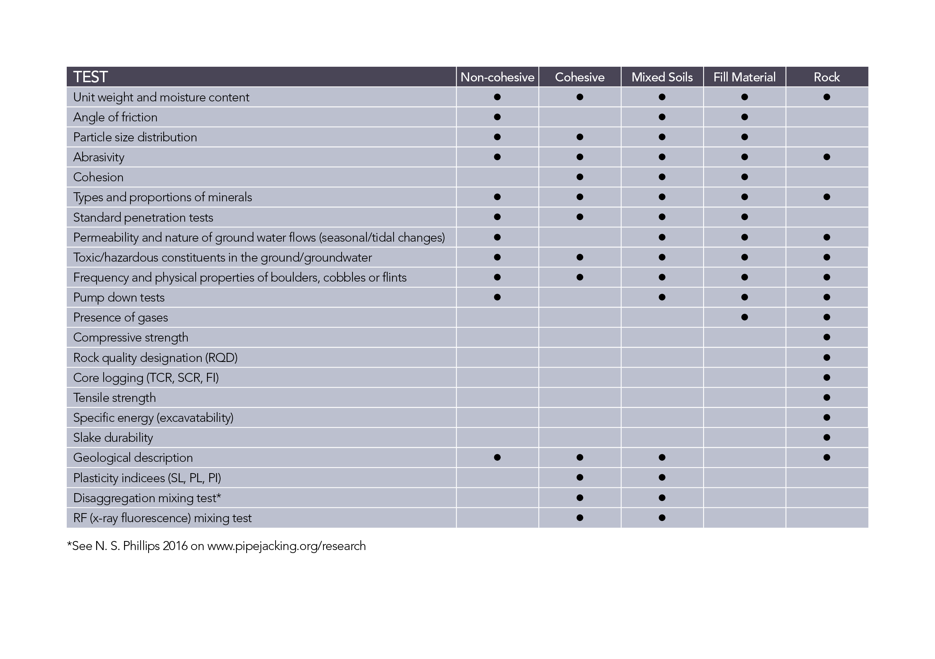
Soil Conditions
Notes:
The choice of excavation method will depend on ground conditions. Unstable ground at the face of the tunnel must be controlled to prevent ground loss, and to enable mining to take place safely. This can be achieved using a suitable tunnelling machine or by stabilising the face using appropriate geotechnical processes.

Slide 19
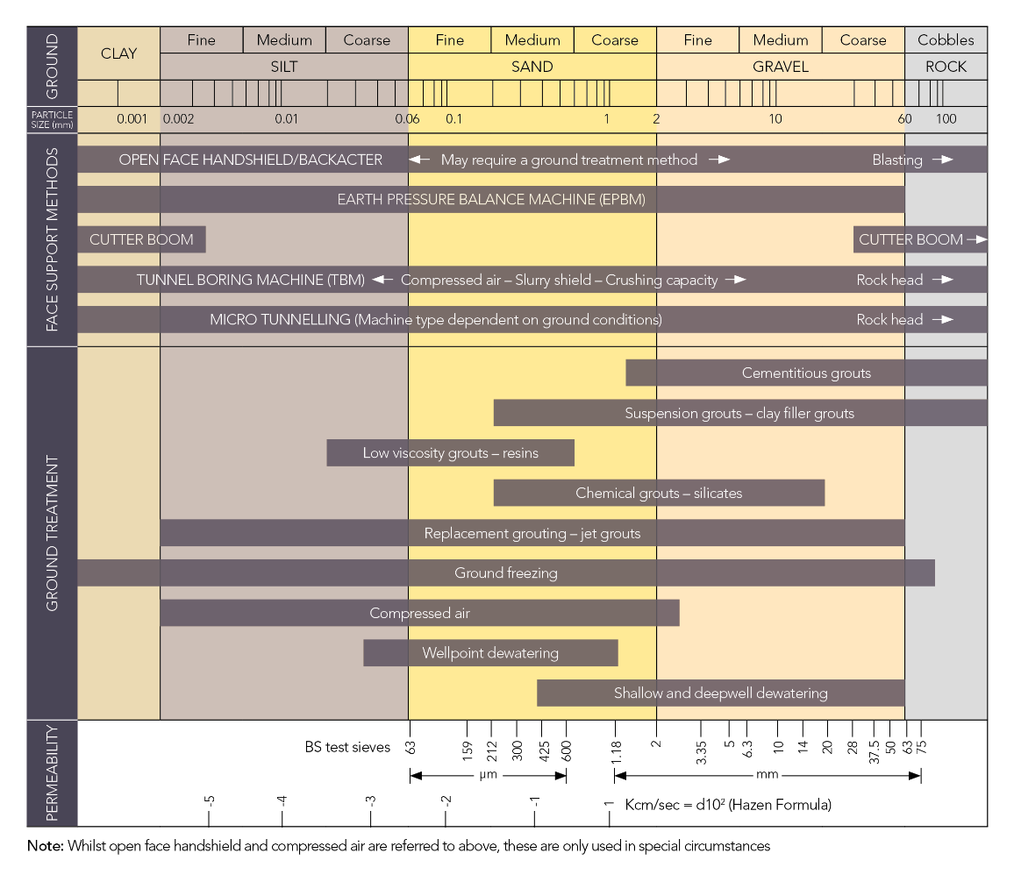
Tunnelling in Unstable Ground
Notes:
Tunnelling method selection depends on ground stability. Unstable ground can be managed either by suitable machine selection to control face pressures or by stabilising the ground using geotechnical processes. When tunnelling in unstable ground specialist geotechnical advice should be sought.

Slide 20
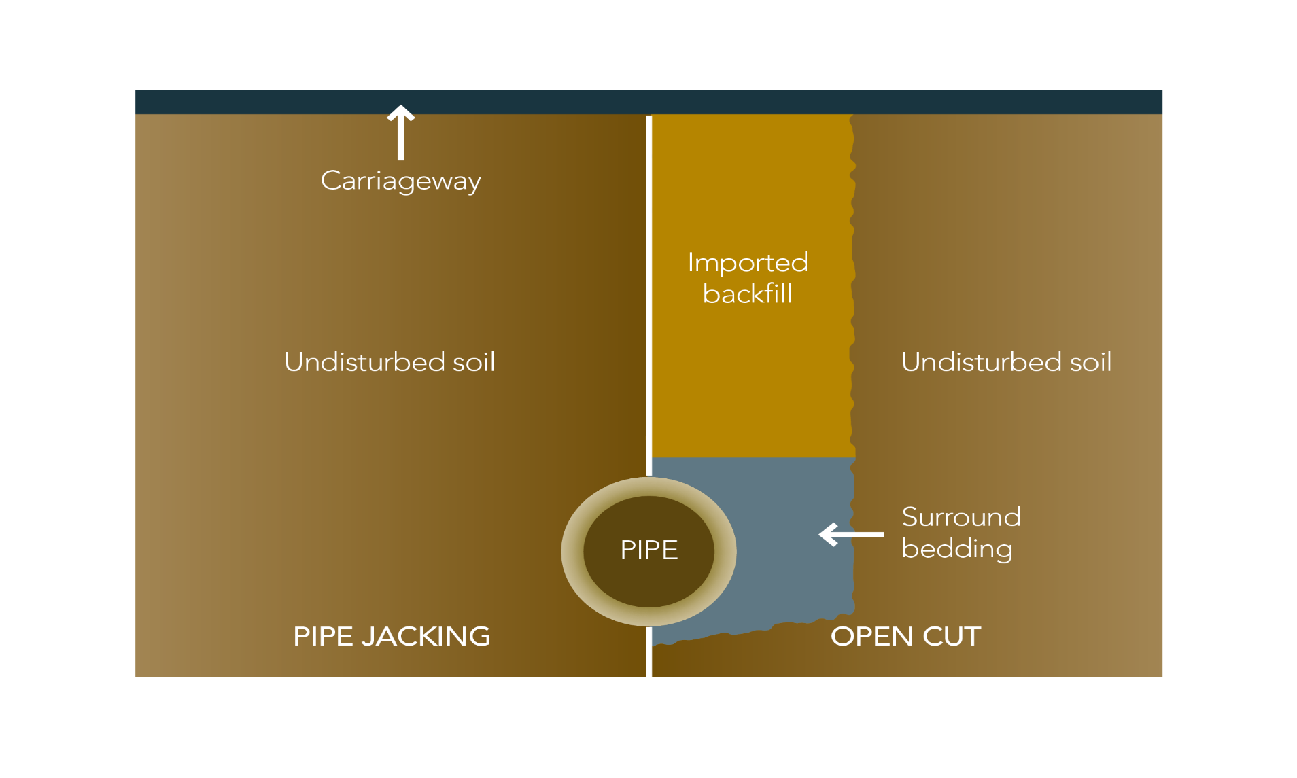
Open Trench vs Pipejacking
Notes:
Comparing open-cut with pipejacking it shows that disruption is largely eliminated. The requirement for excavation is dramatically reduced as there is no requirement for imported fill.

Slide 21
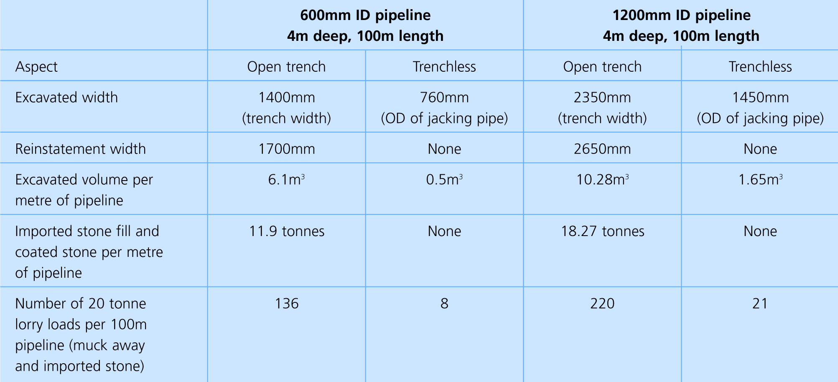
Open Trench vs Pipejacking
Lorry Movements
Notes:
On an average contract, vehicle movements are reduced by 90%, excavated material is only around 8-10% of open cut volumes, and no additional quarried materials are required, so protecting the environment.

Slide 22
Carbon Calculator
Easy to use
Options:
- Feasibility
- As designed
- As built
Notes:
The Transport Research Laboratory has developed a web-based too for the PJA to compare greenhouse gas emissions for pipe jacking and microtunnelling with open-cut for sewers and utility pipeline installation. The data sources and methodology has been peer reviewed by the Water Research Centre.

Slide 23
Carbon Calculator
CO₂ Savings – 500 metres
Notes:
This example demonstrates the significant carbon savings that can be achieved over 500 metres.

Slide 24
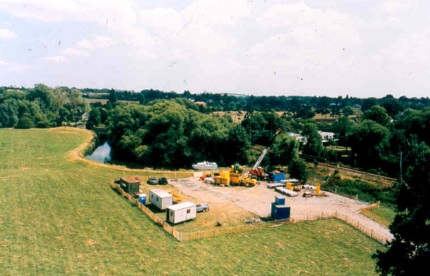
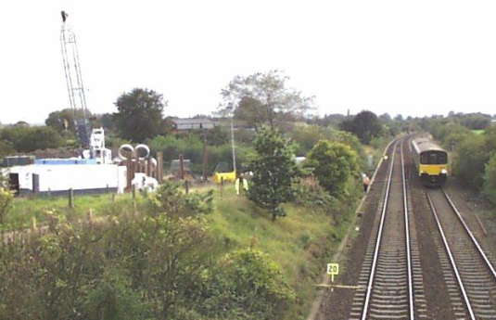
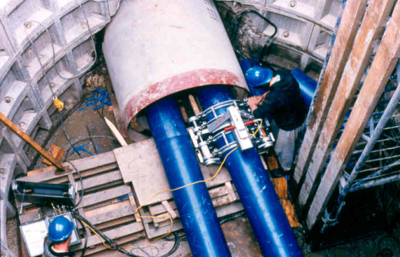
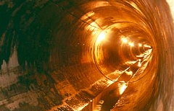
Major Applications
  New sewerage and drainage construction
  Sewer replacement and lining
  Gas and water mains
  Oil pipelines
  Electricity and telecoms cable ducts
  Subways
Notes:
A major application for pipejacking is for new foul and surface water drainage, culverts and watercourses. It is also used for crossings under roads, railways, rivers and canals for the installation of gas and water mains, oil pipelines, electricity and telecommunications cable ducts, and subways

Slide 25
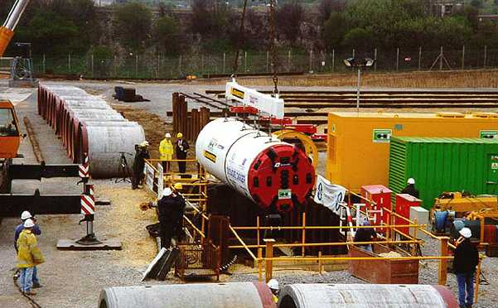
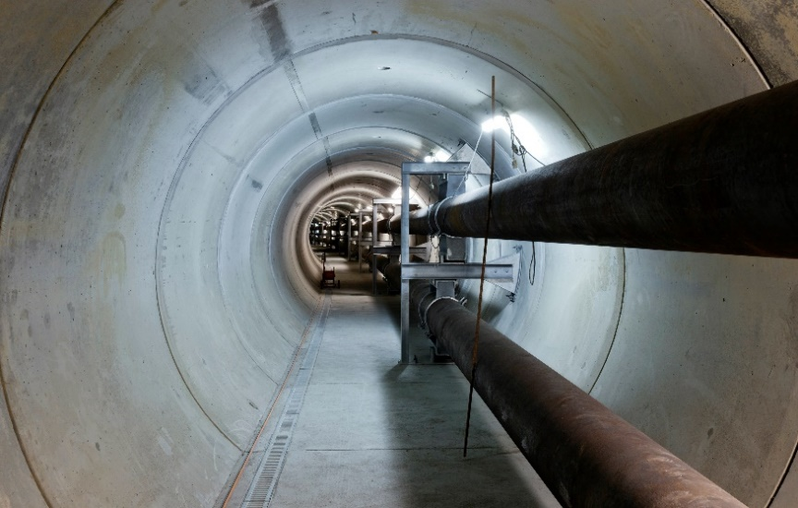
Technical Benefits
Inherent strength
Smooth internal finish
No secondary lining
Fewer joints
Watertight
Inverts for combined systems
Less settlement
Minimal surface impact
Fewer utility diversions
Notes:
Pipe jacking provides the best engineered, safest and most cost effective form of tunnel lining available and is applicable in a wide range of ground conditions.

Slide 26
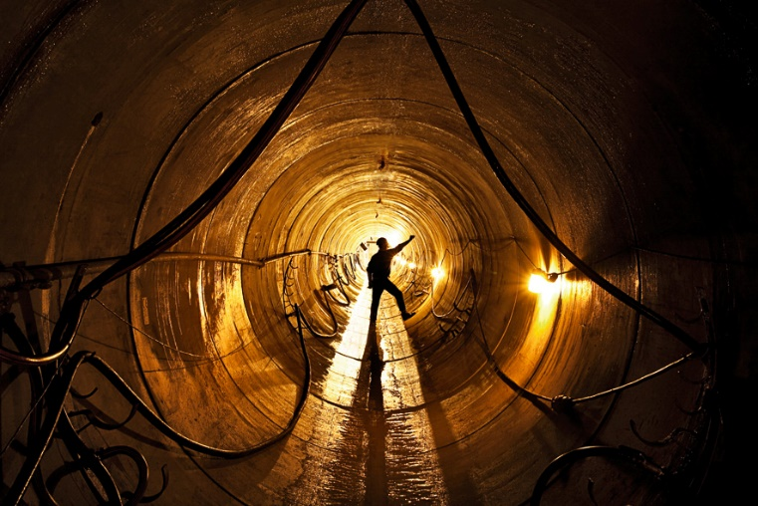
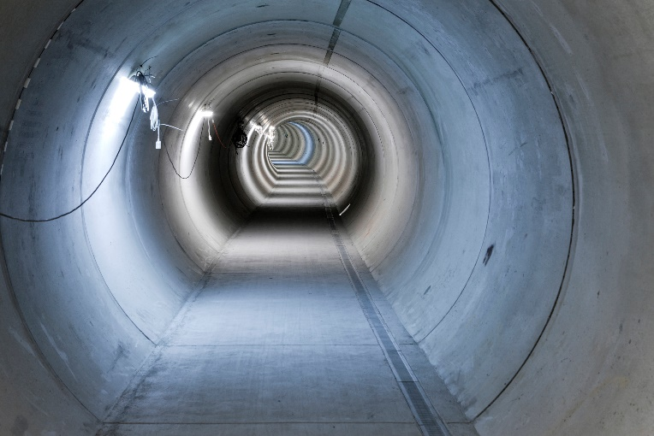
Safety Benefits
Inherently safer method
Quicker installation
Reduced labour input
Utility strikes minimised
Public interface reduced
Reduced confined space
man hours
Notes:
Pipe jacking and microtunelling are inherently safe tunnelling systems. Man hours worked are substantially reduced as are the risks of utility strikes. Surface disruption is minimised and the finished structure is maintenance free.

Slide 27
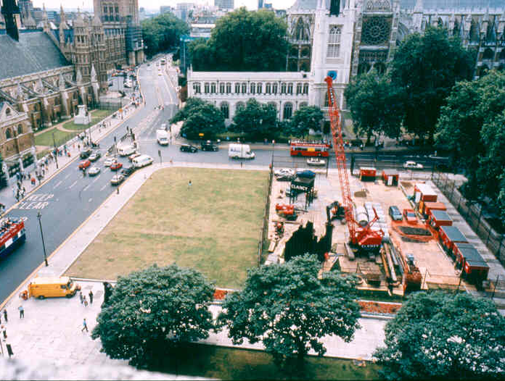
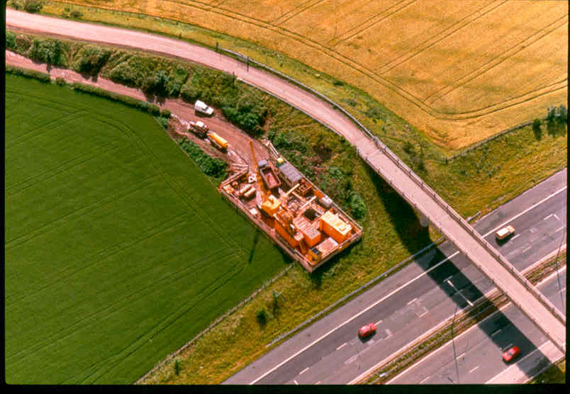
Sustainability:
Environmental and socio-economic benefits
Reduces disruption
Reduces damage to services
Maintains highway integrity
90% fewer vehicle movements
Less spoil
Less quarried material
Reduced CO₂ emissions
No secondary lining
Economic alternative to deep
open cut
Socially acceptable
Notes:
Compared to open-cut trenching, pipe jacking and microtunnelling systems reduce the social and environmental disturbance for the installation of services in urban areas

Slide 28
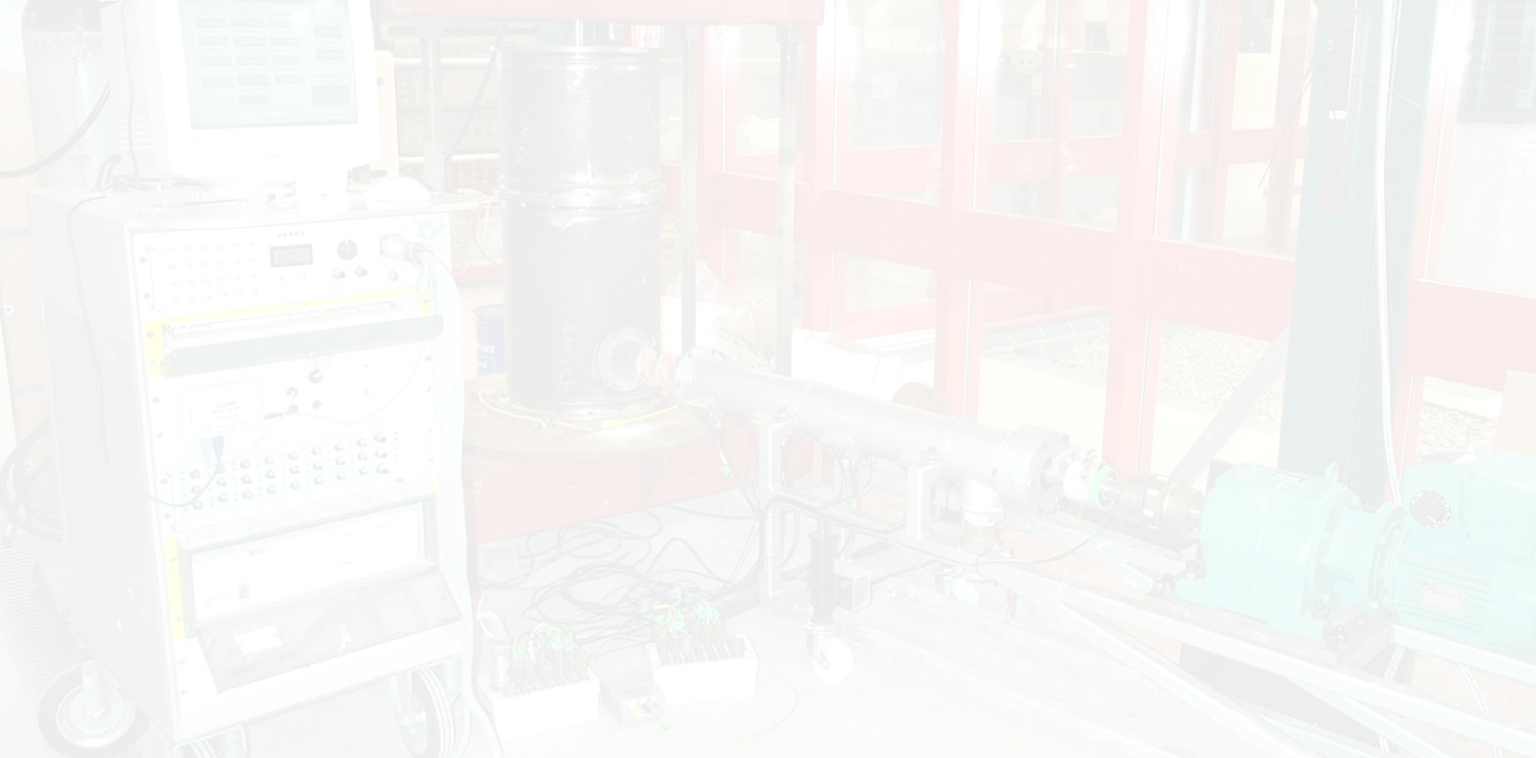
Research Projects at Leading Universities
University research programme initiated in 1986 – projects include:
Laboratory testing of model jacked pipes
Field testing of performance of pipes
Finite element analysis of concrete jacking pipes
Full scale testing of concrete pipes
Soil conditioning and lubrication materials
Field testing of soil conditioning and lubrication methods
Slurry management and soil disaggregation
Notes:
Research has been carried out at leading universities to include the design and performance of jacking pipes, the interaction between the soil and pipes using a variety of lubricants, and the effect of various conditioners on the efficiency of the overall jacking process, including excavation. Full details of research activities are available on the PJA website.

Slide 29
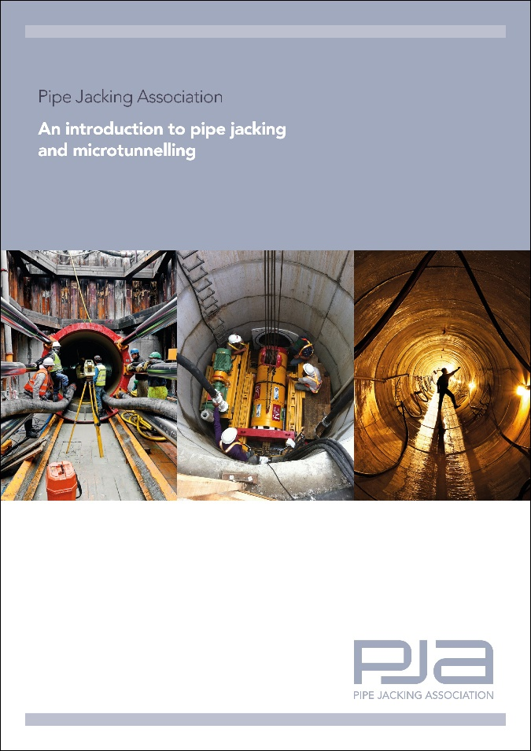
PJA Publications and Design Advice
Introduction to pipe jacking
Detailed design guide
Videos and presentations
Preferred pipe sizes
Case studies
Research
Carbon calculator
Contractors, pipe and other suppliers
Safety guidance
Downloadable from website
Notes:
The PJA produce a range of publications to include a general overview, a detailed design guide, case studies, guidance for designers, videos and presentations. These are downloadable from the PJA website.

Slide 30
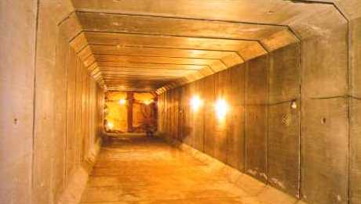
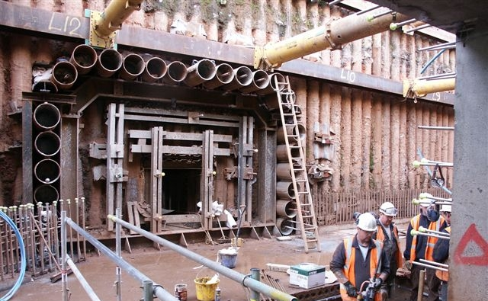
Additional Applications
Box Sections
Subways
Roadways
Other uses
Jacked arches
Bridge slide foundations
Notes:
In addition to conventional conduits pipe jacking has a variety of specialist applications. These include box sections for subways and roadways, bridge foundations for bridge slides and also jacked arches.

Slide 31
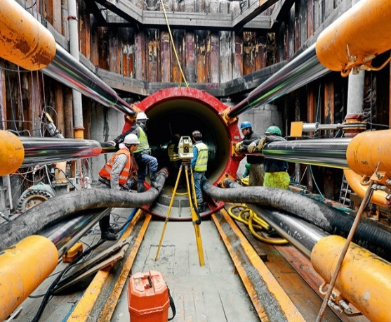
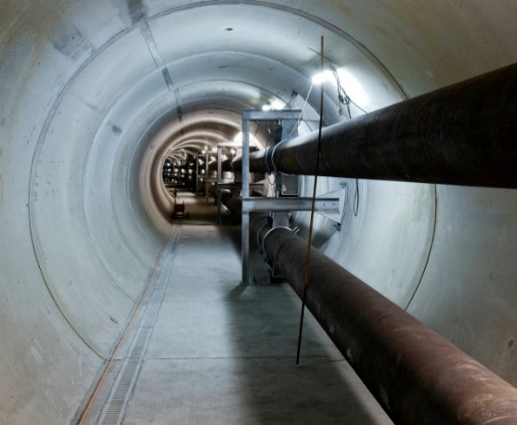
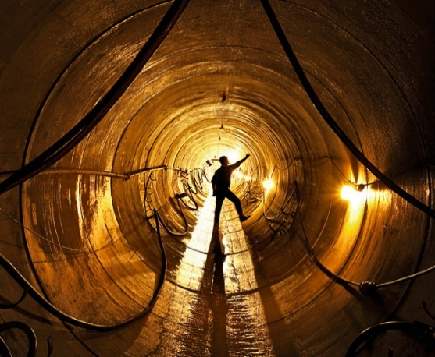
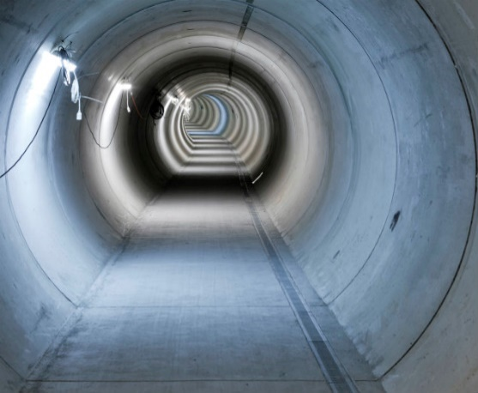
Summary
Engineering integrity
Low capital costs
Low maintenance
Cost-effective
Safe installation
Environmental benefits
Reduced CO₂ emissions
Extensively used
150mm to 2.4/3m diameters
Long drive lengths
Straight or curved drives
Notes:
To summarise: pipe jacking is a proven system extensively used extensively for sewerage infrastructure and other utility installations. Pipe diameters typically range from 150mm to 2.4 metres and can be greater when required. Drive lengths of up to 1,000 metres are readily achievable and considerably longer lengths have been successfully jacked. Drives can be either in a straight line, to a radius, or a series of radii. Pipe jacking delivers improved engineering performance and integrity over alternative tunnelling systems.

Slide 32
www.pipejacking.org

